Slide 1

Noida Institute of Engineering and Technology, Greater Noida
Financial Products & Services
Unit: V
Subject Name:
Finance for Engineers
(AOE0770)
Amit Kumar
Assistant Professor
Department: School of Management
Course Details MTech Int(IT-VIII Semester)

Slide 2
Index/Content
S. No. | Index
1. | Name of Subject with code, Course and Subject Teacher
2. | Brief Introduction of Faculty member with Photograph
3. | Evaluation Scheme
4. | Syllabus
5. | Branch wise Application
6. | Course Objective(s)
7. | Course Outcome(s)
8. | Program Outcomes (POs)
9. | Cos and POs Mapping

Slide 3
Index/Content
S. No. | Index
10. | Program Specific Outcomes (PSOs)
11. | Cos and PSOs Mapping
12. | Program Educational Objectives (PEOs)
13. | Result Analysis
14. | End Semester Question paper Templates
15. | Prequisite/Recap
16. | Brief Introduction about the Subject with Videos
17. | Unit Contents
18. | Unit Objectives
19. | Topic Objectives/Topic Outcome

Slide 4
Index/Content
S. No. | Index
20. | Lecture related to topic
21. | Daily Quiz
22. | Weekly Assignment
23. | Topic Links
24. | MCQs
25. | Glossary Questions
26. | Old question papers
27. | Expected Questions
28. | Recap of unit

Slide 5

Noida Institute of Engineering and Technology, Greater Noida
Amit Kumar
Assistant Professor
Department: Management Studies (MBA)
Email ID: amitkumar.mba@niet.co.in
Qualification: B.Com, M.Com
Specialisation: Finance

Slide 6
Syllabus
Course Contents / Syllabus
UNIT-I Basics of Accounting Hours- 9
Basics of Accounting: Principles of Accounting , Concept of debit & credit, Books of accounts, Journal, Ledgers, Basic Accounting terminologies, Overview to Deprecation (straight line and diminishing method)
UNIT-II Financial Statements Analysis Hours-9
Financial Statements: Income statement & Position statement: Preparation and analysis Key financial ratios, their interpretation, comparison of ratio with competition to identify improvement areas

Slide 7
Syllabus
UNIT-III Project Finance Hours-8
Appraisal of projects: Techniques, Finance for Startups- Govt Schemes / PSU &PSE Bank Finance, Bank Scrutiny for approvals etc., Project Budgeting, Capex, Opex and Importance of tracking cost of projects in execution,
UNIT-IV Working Capital Management Hours-8
Concepts of Working Capital and its types, Approaches to working capital, Inventory management: Nature, Objective, Techniques of inventory management, Cash Management: Objectives, preparation of Cash Flow Statement and its analysis.

Slide 8
Syllabus
UNIT-V Financial Products & Services Hours-6
Introduction to Personal Financial Portfolio Management, Key Options of Savings &Investment – Debt, Equity, etc. Brief Introduction to Mutual Funds and Stock Market

Slide 9
Branch wise Applications
Financial accounting can be used in short-term and long-term decisions involving the financial health of a company.
Financial accounting helps managers make operational decisions–intended to help increase the company's operational efficiency–which also helps in making long-term investment decisions.
Forecasting, monitoring, and tracking performance is a critical aspect of managerial accounting to ensure actual results meet the budgets and forecasts outlined at the onset.
Financial accounting is the type of accounting that provides financial information to top and middle level management in a company.

Slide 10
Branch wise Applications
Financial accounting often involves various financial metrics, including revenue, sales, operating expenses, and cost controls.
Financial accounting helps companies plan, forecast, and budget at an enterprise-wide level to ensure the company's long-term success.

Slide 11
Result Analysis
S. No. | Subject & Code | Batch | Result(%)
1. | Finance for Engineers(AOE0770) | 2020-24 | Not Available

Slide 12
Session Learning Objectives
Students will be able to know the following concepts:
Introduction to Personal Financial Portfolio Management,
Key Options of Savings &Investment – Debt, Equity, etc.
Brief Introduction to Mutual Funds and Stock Market

Slide 13
Topic Mapping with course outcomes
Unit-V | So. No. | Mapping
 |  | Topic | Course Outcomes | Level
V | 1 | Introduction to financial system Financial Assets/Instruments | CO5 CO2 | High Low
 | 2 | Major Financial Instruments Financial Flows in the economy | CO5 CO2 | High Medium

Slide 14
Topic objectives
Students will be able to know the following concepts:
Introduction to Personal Financial Portfolio Management,
Key Options of Savings &Investment – Debt, Equity, etc.
Brief Introduction to Mutual Funds and Stock Market

Slide 15
Introduction to Personal Financial Portfolio
Personal financial portfolio management is a crucial aspect of managing one's finances effectively.
A financial portfolio refers to a collection of all your financial assets, including investments, savings, and other holdings.
Portfolio management involves making decisions about your investments and financial resources to achieve specific financial goals while considering your risk tolerance and time horizon.

Slide 16
Introduction to Personal Financial Portfolio
Here's an introduction to key concepts in personal financial portfolio management:
Defining Financial Goals
Risk Tolerance
Asset Allocation
Investment Selection

Slide 17
Introduction to Personal Financial Portfolio
5. Rebalancing
6. Emergency Fund
7. Monitoring and Review
8. Tax Efficiency
9. Professional Advice
10. Continuous Learning

Slide 18
Introduction
It facilitates the flow of funds from households (savers) to business firms (investors) to aid in the creation of wealth and development of both parties.
The financial system of a country is concerned with the allocation and Mobilization of savings. Provision of funds.
An institutional framework existing in a country to enable financial transactions
Financial assets (loans, deposits, bonds, equities, etc.)

Slide 19
Introduction
Financial institutions (banks, mutual funds, insurance companies, etc.
Financial markets (money, capital, forex, etc.
Performs an important clearinghouse function, facilitating transactions between payers and payees.

Slide 20
Financial Assets/Instruments
Enable channelizing funds from surplus units to deficit units
There are instruments for savers such as deposits, equities, mutual fund units, etc.
There are instruments for borrowers such as loans, overdrafts, etc.
Like businesses, governments too raise funds through issuing of bonds, Treasury bills, etc.
Instruments like PPF, KVP,(Kisan vikas Patra) etc. are available to savers who wish to lend money to the government

Slide 21
Financial Assets/Instruments
Major Financial Instruments
Money
Savings account
Credit market Instruments-bonds, mortgages
Common Stocks
Money market funds and mutual funds
Pension funds
Financial Derivatives

Slide 22
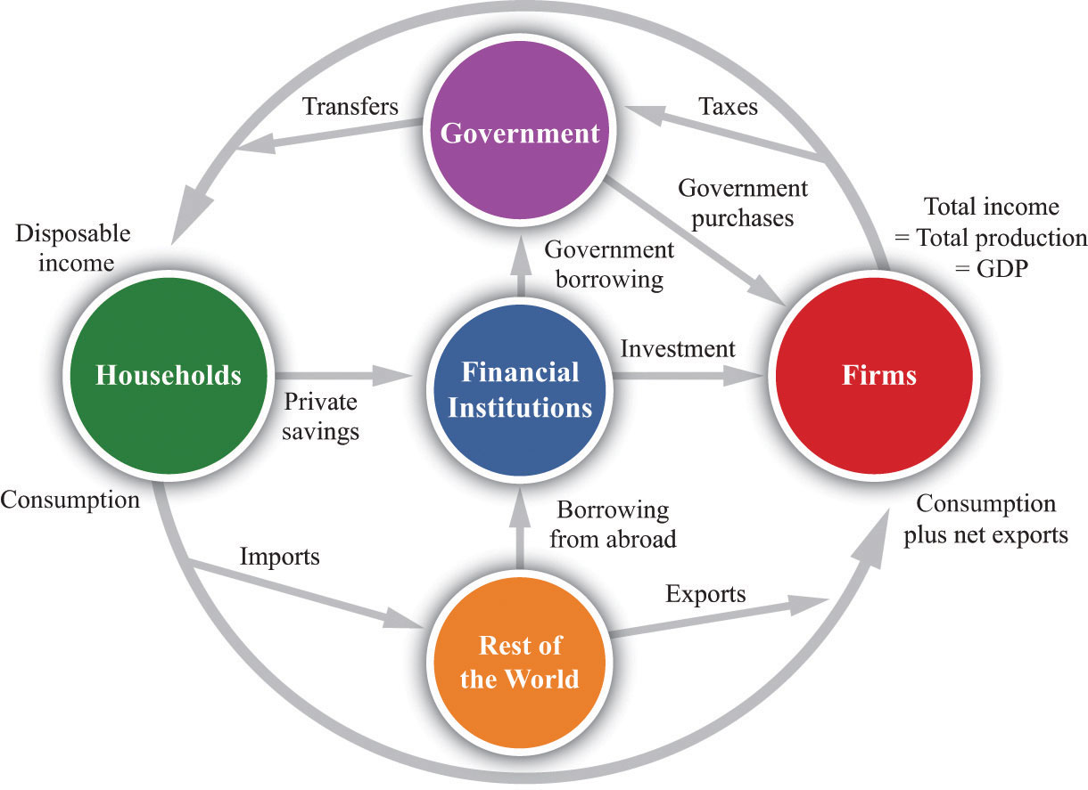
Financial Flows in the economy
Source: www.google.com

Slide 23
Financial Institutions
Includes institutions and mechanisms which
Affect generation of savings by the community
Mobilization of savings
Effective distribution of savings
Institutions are banks, insurance companies, mutual funds- promote/mobilize savings
Individual investors, industrial and trading companies- borrowers

Slide 24
Financial Institutions
Financial Markets
Money Market- for short-term funds (less than a year)
Organized (Banks)
Unorganized (money lenders, chit funds, etc.)
Capital Market- for long-term funds
Primary Issues Market Stock Market
Bond Market

Slide 25
Organized Money Market
Organized Money Market
Call money market
Bill Market (Treasury bills ,Commercial bills etc.)
Bank loans (short-term)
Organised money market comprises RBI, banks (commercial and co-operative)

Slide 26
Call money market
Call money market
Is an integral part of the Indian money market where day-to-day surplus funds (mostly of banks) are traded.
The loans are of short-term duration (1 to 14 days). Money lent for one day is called ‘call money’; if it exceeds 1 day but is less than 15 days it is called ‘notice money’. Money lent for more than 15 days is ‘term money’
The borrowing is exclusively limited to banks, who are temporarily short of funds.
Call loans are generally made on a clean basis- i.e. no collateral is required

Slide 27
Call Money Market Participants
Call Money Market Participants
Those who can both borrow and lend in the market – RBI , banks and primary dealers
Once upon a time, select financial institutions viz., IDBI, UTI, Mutual funds were allowed in the call money market only on the lender’s side
These were phased out and call money market is now a pure inter-bank market

Slide 28
Bill Market
Bill Market
Treasury Bill market- Also called the T-Bill market
These bills are short-term liabilities (91-day, 182-day, 364-day) of the Government of India
It is an IOU of the government, a promise to pay the stated amount after expiry of the stated period from the date of issue

Slide 29
Bill Market
They are issued at discount to the face value and at the end of maturity the face value is paid
The rate of discount and the corresponding issue price are determined at each auction
RBI auctions 91-day T-Bills on a weekly basis, 182- day T-Bills and 364-day T-Bills on a fortnightly basis on behalf of the central government

Slide 30
Money Market Instruments
Money Market Instruments:
Money market instruments are those which have maturity period of less than one year.
The most active part of the money market is the market for overnight call and term money between banks and institutions and repo transactions
Call money/repo are very short-term money market products

Slide 31
Daily Quiz
1. Define finance.
2. Discuss financial institutions.
3. Define funds.
4. What is call money?
5. Discuss commercial paper.
6. Explain treasury bills.
Explain money market.
What is bond?
What is capital market?
Define stock market.

Slide 32
Summary
We have covered the following topics in this lecture:
Introduction to financial system
Financial Assets/Instruments
Major Financial Instruments
Financial Flows in the economy
Financial Markets
Purpose of the money market
Money Market Instruments

Slide 33
Prerequisite and Recap
Introduction to financial system
Financial Assets/Instruments
Major Financial Instruments
Financial Flows in the economy
Financial Markets
Purpose of the money market
Money Market Instruments

Slide 34
Topic Mapping with course outcomes
Unit-V | So. No. | Mapping
 |  | Topic | Course Outcomes | Level
V | 1 | Mutual funds Types of Mutual funds | CO5 CO4 | High Medium
 | 2 | Introduction to financial Derivatives | CO5 CO4 | High Medium

Slide 35
Objectives of topic/Session
Students will be able to know the following concepts:
Mutual funds
Types of Mutual funds
Introduction to financial Derivatives

Slide 36
Mutual Fund
A Mutual Fund is a trust that pools the savings of a number of investors who share a common financial goal.
• The money thus collected is then invested in capital market instruments such as shares, debentures and other securities.
• The income earned through these investments and the capital appreciation released are shared by its unit holders in proportion to the number of units owned by them.

Slide 37
Types of Mutual Funds
. On the basis of Structure
1. OPEN ENDED SCHEMES:
• Open ended Schemes are schemes which offers unit for sale without specifying any duration for redemption.
• They sell and repurchase schemes on a continuous basis.
• The main feature of such kind of scheme is liquidity

Slide 38
Types of Mutual Funds
2. CLOSED ENDED SCHEMES:
• These are the schemes in which redemption period is specified.
• Once the units are sold by mutual funds, then any transaction takes place in secondary market only i.e. stock exchange.
• Price is determined by forces of market.

Slide 39
Types of Mutual Funds
On the basis of investment objectives
1. Growth Fund:
• The aim of growth funds is to provide capital appreciation over the medium to long- term. Such schemes normally invest a major part of their corpus in equities. Such funds have comparatively high risks
2. Income Funds:
• Funds that invest in medium to long-term debt instruments issued by private companies, banks, financial institutions, governments and other entities belonging to various sectors (like infrastructure companies etc.) are known as Debt / Income Funds

Slide 40
Types of Mutual Funds
Balanced Fund
• These funds provide both growth and regular income as these schemes invest in debt and equity.
• The NAV of these schemes is less volatile as compared pure equity funds.
Money Market Funds
• Money market / liquid funds invest in short-term (maturing within one year) interest bearing debt instruments. These securities are highly liquid and provide safety of investment, thus making money market / liquid funds the safest investment option when compared with other mutual fund types.

Slide 41
Types of Mutual Funds
On the basis of Special Schemes
Industry specific schemes:
• Industry Specific Schemes invest only in the industries specified in the offer document. The investment of these funds is limited to specific industries like Infotech, FMCG, Pharmaceuticals etc
2. Index schemes:
• In this schemes, the funds collected by mutual funds are invested in shares forming the Stock Exchange Index.
• Example- Nifty Index Scheme of UTI Mutual Fund and Sensex Index Scheme of Tata Mutual Fund

Slide 42
Types of Mutual Funds
3. Sectoral schemes
• Sectoral funds are those mutual funds which invest in a particular sector of the market, e.g. banking, information technology etc. Sector funds are riskier than equity diversified funds since they invest in shares belonging to a particular sector which gives them fewer diversification opportunities

Slide 43
Daily Quiz
1. Define fund.
2. What is mutual fund.
3. Define closed ended fund.
4. What is open ended fund?
5. Discuss finance.
6. Explain two features of mutual funds.
Explain two benefits of mutual funds.
What is debenture?
What is capital market?
Define investment.

Slide 44
Summary
We have covered the following topics in this lecture:
Mutual funds
Types of Mutual funds
Introduction to financial Derivatives

Slide 45
Prerequisite and Recap
Mutual funds
Types of Mutual funds
Introduction to financial Derivatives

Slide 46
Personal financial portfolio management
Personal financial portfolio management is a strategic approach to managing an individual's financial assets to achieve specific financial goals. A financial portfolio typically consists of a diverse range of investments, such as stocks, bonds, mutual funds, real estate, and other financial instruments. The primary goal of portfolio management is to optimize returns while managing risk according to an individual's risk tolerance, time horizon, and financial objectives.

Slide 47
Personal financial portfolio management
Here's an introduction to key concepts and principles of personal financial portfolio management:
Setting Financial Goals
Risk Tolerance
Asset Allocation
Investment Vehicles
Diversification
Portfolio Rebalancing
Risk Management
Regular Monitoring

Slide 48
Personal financial portfolio management
9. Tax Considerations
10. Financial Advisor Consultation
11. Long-Term Perspective

Slide 49
Key Options of Savings &Investment
Savings and investments are crucial components of personal finance, helping individuals build wealth, achieve financial goals, and secure their future. Here are key options for savings and investments:
Saving Account
Certificates of Deposit (CDs)
Money Market Accounts
Treasury Securities
Stocks
Bonds
Mutual Funds
Exchange-Traded Funds (ETFs)

Slide 50
Key Options of Savings &Investment
9. Real Estate
10. Retirement Accounts
11. Precious Metals
12. Crypto currencies
13. Eeducation Savings Accounts

Slide 51
Stock Market
The stock market, also known as the equity market, is a centralized marketplace where buyers and sellers trade shares of publicly listed companies. It plays a crucial role in the global economy by facilitating the allocation of capital, enabling companies to raise funds, and providing individuals with opportunities to invest and build wealth. Here are key aspects of the stock market:
Primary and Secondary Markets
Stock Exchanges
Shares and Equity Ownership
Stock Prices and Market Indices
Trading Mechanisms
Bull and Bear Markets

Slide 52
Stock Market
7. Risk and Volatility
8. Fundamental and Technical Analysis
9. Long-Term vs. Short-Term Investing

Slide 53
Stock Market
Factors affecting the stock market
Economic Indicators
Interest Rates
Corporate Earnings
Market Sentiment
Technological Advances
Regulatory Changes
Currency Fluctuations
Market Liquidity

Slide 54
Stock Market
Players in stock market
1. Investors:
Individual Investors: These are individuals who buy and sell stocks for personal investment purposes. They can be classified into different categories based on their investment strategies, such as day traders, swing traders, and long-term investors.
Institutional Investors: This category includes large entities like mutual funds, pension funds, insurance companies, and hedge funds. Institutional investors often manage significant amounts of money on behalf of multiple clients.

Slide 55
Stock Market
Players in stock market
2. Traders:
Day Traders: Individuals or institutional traders who buy and sell securities within the same trading day to take advantage of short-term price movements.
Swing Traders: Traders who hold positions for a few days to weeks, aiming to profit from price "swings" within a trend.
3. Stockbrokers:
Full-Service Brokers: These brokers offer a range of services, including investment advice, research, and financial planning. They often charge higher commissions.
Discount Brokers: These brokers provide a platform for trading stocks at a lower cost but typically offer fewer advisory services compared to full-service brokers.

Slide 56
Stock Market
Players in stock market
4. Market Makers:
These are firms or individuals that facilitate the buying and selling of financial instruments by providing liquidity. They do so by quoting both buy and sell prices for a financial instrument, profiting from the spread between these prices.
5. Exchanges:
Stock Exchanges: Examples include the NSE Exchange. Exchanges provide a platform for the buying and selling of stocks, ensuring transparency and fairness in the process.
Over-the-Counter (OTC) Markets: In addition to formal exchanges, some stocks are traded over-the-counter, where trading occurs directly between parties rather than through a centralized exchange.

Slide 57
Stock Market
Players in stock market
6. Regulators:
Government agencies such as the SEBI play a crucial role in regulating and overseeing the securities industry. They enforce rules and regulations to protect investors and maintain the integrity of the markets.
7. Financial Analysts:
Analysts working for investment banks, financial institutions, or independent research firms analyze companies and market trends to provide insights to investors and traders.
8.Corporate Issuers:
Companies that issue stocks to raise capital from the public. Shareholders become partial owners of the company, and the stocks are traded on the open market.

Slide 58
Stock Market
Players in stock market
9. Financial Media:
News outlets, financial websites, and television networks provide information, analysis, and commentary on market events. They play a role in shaping investor sentiment.
10. Clearing Houses:
These entities ensure the settlement of trades by acting as intermediaries between buyers and sellers. They guarantee the completion of transactions and reduce counterparty risk.

Slide 59
Stock Market
Stock market in India
1. National Stock Exchange (NSE):
NSE is the largest stock exchange in India in terms of market capitalization and is located in Mumbai. It was established in 1992.
2. Bombay Stock Exchange (BSE):
BSE is one of the oldest stock exchanges in Asia and is also located in Mumbai. It was established in 1875.
3. Multi Commodity Exchange of India Ltd (MCX):
MCX is a commodity exchange in India, dealing primarily with commodity futures trading. It is headquartered in Mumbai.
4. National Commodity & Derivatives Exchange Limited (NCDEX):
NCDEX is another major commodity exchange in India, specializing in agricultural commodities. It is headquartered in Mumbai.

Slide 60
Stock Market
5. Calcutta Stock Exchange (CSE):
CSE is one of the regional stock exchanges in India, located in Kolkata. It has a significant history but has seen reduced activity in recent years.
6. India International Exchange (India INX):
India INX is located at the International Financial Services Centre (IFSC) in Gujarat. It is India's first international exchange and provides a platform for global investors.
7. BSE Institute Ltd (BIL):
BIL is a subsidiary of BSE and is focused on providing education and training related to financial markets and services.
8. Interconnected Stock Exchange of India Ltd (ISE):
ISE is a national-level stock exchange with a presence in multiple cities. It aims to provide a platform for small and medium-sized enterprises (SMEs).

Slide 61
Stock Market
9. Metropolitan Stock Exchange of India Ltd (MSE):
MSE is another stock exchange in India, with a focus on providing an efficient and transparent platform for trading.

Slide 62
Quiz
Define the Finance.
Discuss the financial Institutions.
Stock.
Primary Market
Secondary market
Equity Share
Bonds.
Saving Account.
Post office scheme.
Crypto Currencies.

Slide 63
Faculty Video Links
Youtube/other Video Links
https://youtu.be/zdTqlnSqO48
https://youtu.be/XXB08Xbbk1k
https://youtu.be/pISQMexnmew
https://youtu.be/YuyPL_pDuW4

Slide 64
Daily Quiz
1.What are the aspects of working capital management?
a. Inventory management
b. Receivable management
c. Cash management
d. All of the above
2._________ function includes a firm’s attempts to balance cash inflows and outflows.
a) Finance
b) Liquidity
c) Investment
d) Dividend

Slide 65
Daily Quiz
5. Statement of cash flows includes
A) Financing Activities
B) Operating Activities
C) Investing Activities
D) All of the Above
6. In cash flows, when a firm invests in fixed assets and short-term financial investments results in
A) Increased Equity
B) Increased Liabilities
C) Decreased Cash
D) Increased Cash
7. A firm that issues stocks and bonds to raise funds results in
A) Decreases Cash
B) Increases Cash
C) Increases Equity
D) Increases Liabilities

Slide 66
Weekly Assignment
Q.1 “Explain the financial institutions.
Q.2Explain mutual funds.
Q.3 Describe the five options for savings.

Slide 67
MCQ s
1.What are the aspects of working capital management?
a. Inventory management
b. Receivable management
c. Cash management
d. All of the above
2._________ function includes a firm’s attempts to balance cash inflows and outflows.
a) Finance
b) Liquidity
c) Investment
d) Dividend

Slide 68
MCQ s
3.Firms which are capital intensive rely on _________.
a) Equity
b) Short term debt
c) Debt
d) Retained earnings
4. To financial analysts, "working capital" means the same thing as __________.
a. total assets b. fixed assets c. current assets d. current assets minus current liabilities.

Slide 69
MCQ s
5. Statement of cash flows includes
A) Financing Activities
B) Operating Activities
C) Investing Activities
D) All of the Above
6. In cash flows, when a firm invests in fixed assets and short-term financial investments results in
A) Increased Equity
B) Increased Liabilities
C) Decreased Cash
D) Increased Cash
7. A firm that issues stocks and bonds to raise funds results in
A) Decreases Cash
B) Increases Cash
C) Increases Equity
D) Increases Liabilities

Slide 70
MCQ s
8. 4. The purchase value of assets over its serviceable life is categorized as
A) Appreciated Liabilities
B) Appreciated Assets
C) Depreciation
D) Appreciation
9. The statement of cash flow clarifies cash flows according to
A) Operating and Non-operating Flows
B) Inflow and Outflow
C) Investing and Non-operating Flows
D) Operating, Investing, and Financing Activities
10. Cash flow example from a financial activity is
A) Payment of Dividend
B) Receipt of Dividend on Investment
C) Cash Received from Customers
D) Purchase of Fixed Asset

Slide 71
MCQ s
11. Cash flow example from an investing activity is
A) Issue of Debenture
B) Repayment of Long-term Loan
C) Purchase of Raw Materials for Cash
D) Sale of Investment by Non-Financial Enterprise
12. Cash flow example from an operating activity is
A) Purchase of Own Debenture
B) Sale of Fixed Assets
C) Interest Paid on Term-deposits by a Bank
D) Issue of Equity Share Capital
13. Which item comes under financial activities in cash flow?
A) Redemption of Preference Share
B) Issue of Preference Share
C) Interest Paid
D) All the above

Slide 72
Glossary Questions
Attempt all the parts: please pick the correct option from Glossary:
1. There exists a close association between sales fluctuations and invested amounts in .........................
2. Institute of Chartered Accountants of India suggests and follows the structure of a ......................... form of balance sheet.
3. Under the conventional method, ......................... enters into the calculation of working capital.
4. A company’s operating cycle naturally consists of three most important activities: ......................, ....................... and ....................
5. The ......................... shows the time period over which additional no impulsive sources of working capital financing must be obtained to carry out the firm’s actions.
Current assets , perpendicular , Cash ,Purchasing resources, producing the product, selling the product , Cash alteration cycle

Slide 73
Old Question Papers
MM:100
SECTION A
Attempt all questions in brief. 2 x 10 = 20
What is Financial Accounting?
Define Net Sales and Net Purchases.
Explain Goodwill and Copyright.
What is dividend?
Explain provisions.
What is a Comparative Balance Sheet?
Explain the term solvency of a firm.
What is Schedule of Changes in Working Capital?
Discuss the concept of cash.
What is depreciation?
Source: www.aktuonline.com

Slide 74
Old Question Papers
SECTION B
Attempt any three of the following: 10 x 3 = 30
Discuss various conventions of Accounting.
What are final accounts? Briefly discuss the uses and limitations of final accounts.
What do you understand by Analysis and Interpretation? Explain various tools of analysis of financial statements.
Explain in brief various statements that are prepared in fund flow Analysis. Show the format of each statement.
Differentiate between find flow and cash flow analysis which one is more beneficial for a firm.
Source: www.aktuonline.com

Slide 75
Old Question Papers
SECTION C
Attempt any one part of the following: 10 x 1 = 10
What is the importance of Accounting? Also discuss various types of accounting.
Discuss the role and objectives of International and Indian Accounting Standards.
Attempt any one part of the following: 10 x 1 = 10
What is Journalizing? Explain the concept of Ledger posting and balancing of accounts.
Discuss the adjustment entries. Give any five adjustment entries.
Source: www.aktuonline.com

Slide 76
Old Question Papers
What is Ratio Analysis? Explain various types of ratios and discuss which type of ratios is used in calculating profitability and liquidity of a firm.
Attempt any one part of the following: 10 x 1 = 10
What is a Balance Sheet? Briefly explain Marshalling of Balance sheet with example.
“Fund Flow analysis is an effective tool of managing working capital in a firm.” Explain.
Attempt any one part of the following: 10 x 1 = 10
Elaborate various types of activities that are considered in a Cash Flow Analysis.
What is inventory? Explain various types of inventory.
Source: www.aktuonline.com

Slide 77
Old Question Papers
Attempt any one part of the following: 10 x 1 = 10
State the final accounts. Briefly discuss the uses and limitations of final accounts.
Discuss the importance of Accounting? Also discuss various types of accounting.
Source: www.aktuonline.com

Slide 78
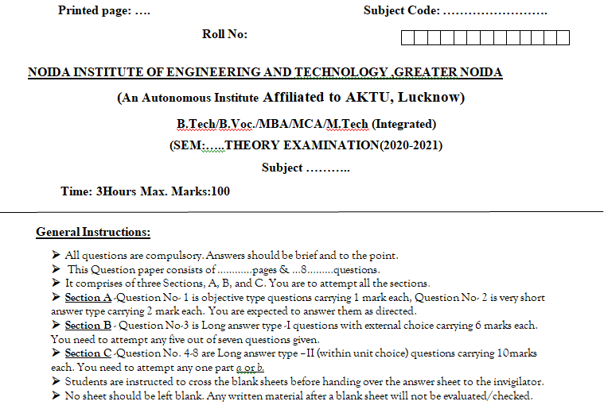
End Semester Question Paper Template

Slide 79
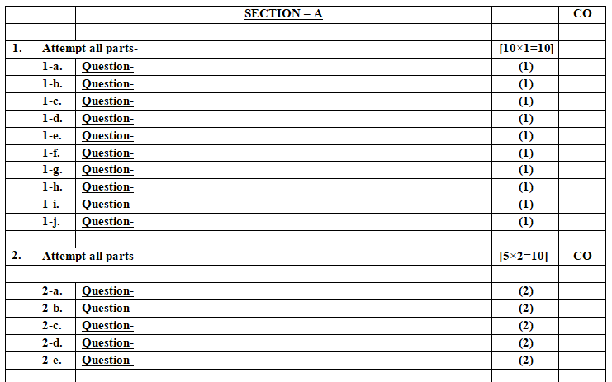
End Semester Question Paper Template

Slide 80
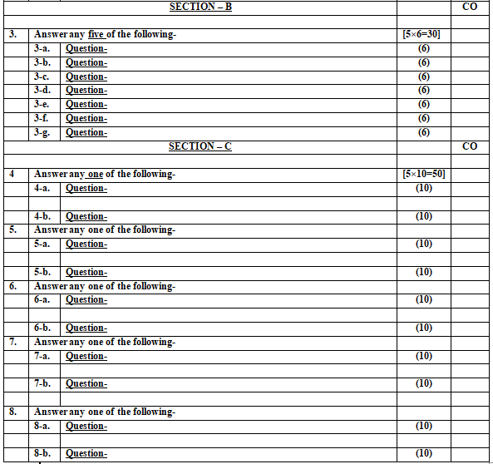
End Semester Question Paper Template

Slide 81
Expected Questions for University Exam
State the meaning of Funds flow statement
How is the schedule of changes in working capital prepared?
Discuss the importance of funds flow statement .
Explain the terms ‘funds items‘ and ‘non funds items. Give examples.
Write short notes on application of funds.
How are the funds from operations calculated?
Distinguish between the funds flow statement and Balance-Sheet.

Slide 82
Expected Questions for University Exam
Explain the terms ‘Funds’ and ‘Flow in funds ’ in respect of funds flow statement
Define Funds Flows statement. How is it prepared? What are the various sources and uses of funds ?
How is a funds flow statement prepared ?Give a Performa of schedule of changes in working capital and funds flow statement.
Explain in brief various statements that are prepared in fund flow Analysis. Show the format of each statement.
Differentiate between find flow and cash flow analysis which one is more beneficial for a firm.
Fund Flow analysis is an effective tool of managing working capital in a firm.” Explain.

Slide 83
Summary
Rules of preparing funds flow statement
Format of funds flow statement
Precautions to be taken while preparing funds flow statement
Numerical problem

Slide 84


References
References:
Source: www.aktuonline.com

Slide 85
References
Thank You

